Slide 1

Cat vs Rabbit Classification
ResNet18 vs EfficientNet-B0 Comparison
Team FIG (Fire, Ice, Gold)
Aayush K.C. • Laxmi Satyal • Pramesh Maharjan
Wright State University • CS 6900: Deep Learning

Slide 2
Problem Statement & Objectives
Develop deep learning model for binary image classification
Compare two architectures: ResNet18 vs EfficientNet-B0
Evaluate transfer learning effectiveness on limited data
Analyze per-epoch metrics (accuracy, precision, recall)
Provide insights into modern CNN architecture design

Slide 3
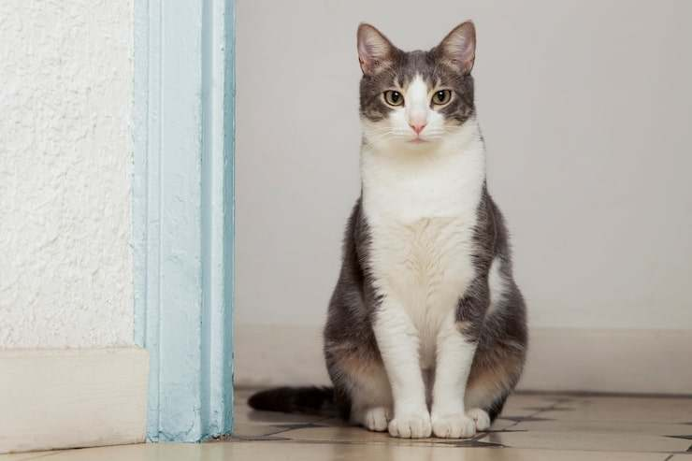
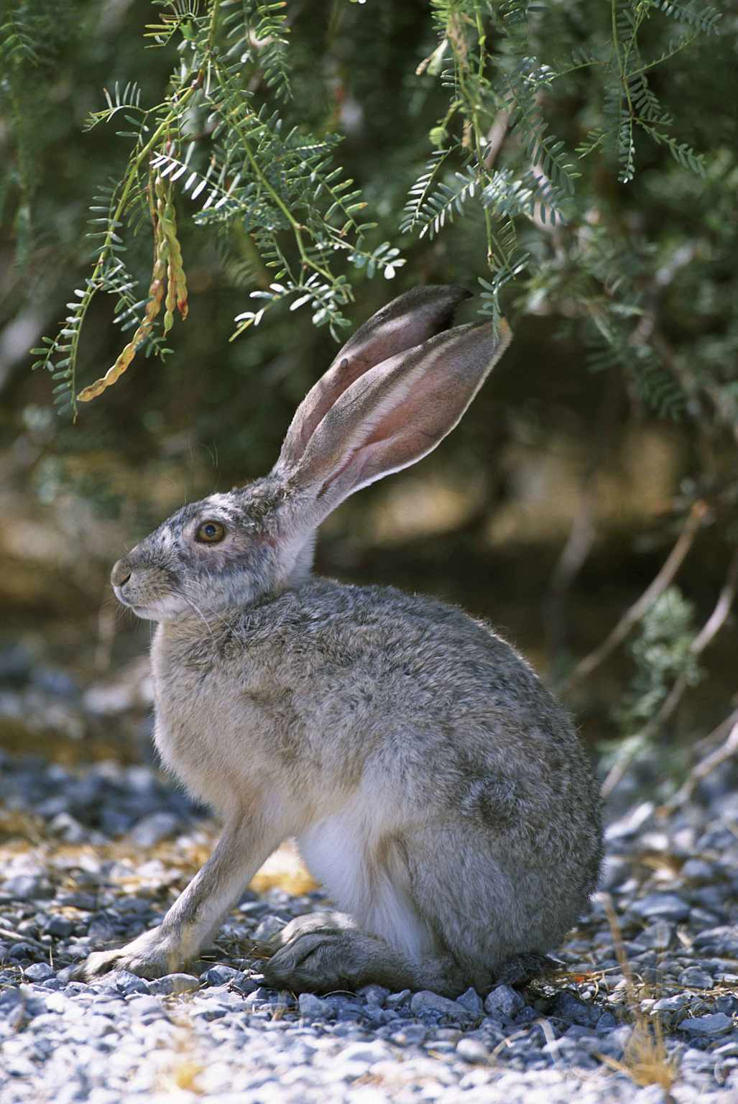
Dataset: Kaggle Cat-Rabbit Images
Dataset Statistics
Total Images: 1,600
Training: 1,280 (80%)
Validation: 320 (20%)
Classes: 2 (Cat, Rabbit)
Resolution: 224×224
Cat
Rabbit

Slide 4
How These Models Work (Simple Explanation)
ResNet18
What it does: 18 layers that learn patterns in images
Special feature: Shortcuts that help train faster
Size: 11.7M parameters (bigger)
Speed: Good but slower
EfficientNet-B0
What it does: Smart, efficient design for accuracy
Special feature: Attention mechanism (focuses on important parts)
Size: 5.3M parameters (55% smaller)
Speed: Very fast & accurate

Slide 5
ResNet18 Algorithm (Detailed & Flowchart)
Input
→
Conv 7×7
→
MaxPool
→
Block 1
224×224
64 channels
3×3 stride 2
64 ch (×2)
Block 2
→
Block 3
→
Block 4
→
Avg Pool
→
FC 512→2
128 ch (×2)
256 ch (×2)
512 ch (×2)
Global
Output
Key Innovation: Residual Connections
Problem: Deep networks forget early features
Solution: Shortcut path that skips blocks
Formula: y = F(x) + x (learn residuals, not full mapping)
Architecture Details
• 18 convolutional layers total
• Each block has 2 3×3 convolutions
• BatchNorm + ReLU after each conv
• 11.7M learnable parameters

Slide 6
EfficientNet-B0 Algorithm (Flowchart)
Smart Features
Input Image
224×224 pixels
Mobile Inverted Bottleneck
Squeeze-Excitation blocks
Only 5.3M parameters
55% smaller than ResNet
↓
Stem Conv 3×3
Initial feature extraction
↓
Attention Mechanism:
7 MBConv Stages
16→24→40→80→112→192→320
Looks at all channels
↓
Asks "Which channels matter most?"
Focuses on important ones
Result: Better accuracy, faster!
Head (1280) + SE Blocks
Attention & refinement
↓
Prediction!

Slide 7


Complete Training Pipeline (Script Flow)
START
→
Load Data
→
Augment
→
Normalize
→
Split
→
DataLoader
1,600 images
Flip, rotate
ImageNet stats
80/20
Batch 32
Init ResNet18
→
Init EfficientNet
→
Replace Heads
→
Set Optimizer
→
Loss Function
→
Move to GPU
ImageNet weights
ImageNet weights
Linear 2 class
Adam lr=0.001
CrossEntropy
CUDA device
TRAIN Loop
VALIDATION
For each batch:
Run on 320 imgs:
FOR Epoch = 1 to 15
→
1. Forward pass
→
• Accuracy
→
Print Epoch Results
2. Compute loss
• Precision
3. Backward pass
• Recall
4. Update weights
• Save best
Load Best
→
Final Eval
→
Compare
→
Plot Curves
→
Confusion
→
COMPLETE!
Checkpoint
Val metrics
Both models
Loss & Acc
Matrices

Slide 8
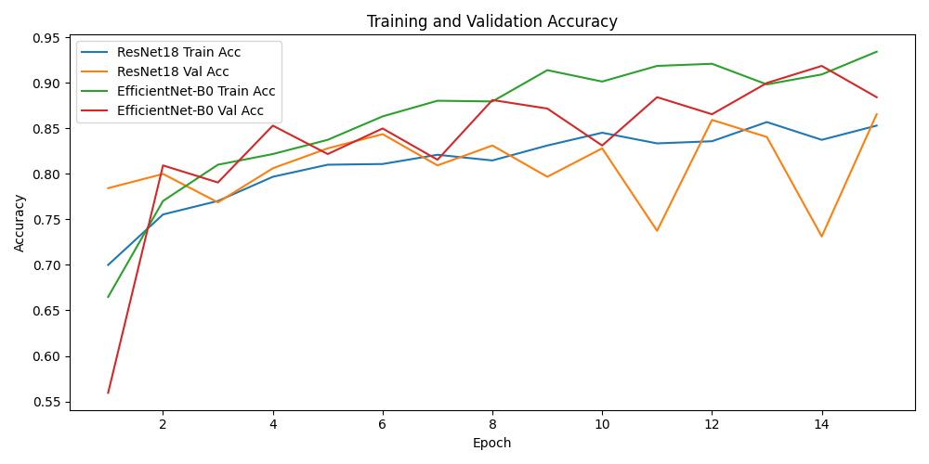
How Both Models Learn (15 Training Epochs)
📈 Accuracy Growth
ResNet (orange) vs EfficientNet (red)
📉 Error Decrease
Lower = Better (Less mistakes)

Slide 9
Per-Epoch Analysis Summary
ResNet18
Epoch 1: 78.44% (strong start)
Epoch 5: 82.81%
Epoch 15: 86.56% (peak)
Overfitting: -1.25% gap
EfficientNet-B0
Epoch 1: 55.94%% (slow start)
Epoch 14: 91.87% (highest)
Epoch 15: 88.44% (decline)
Overfitting: +5.00% gap

Slide 10
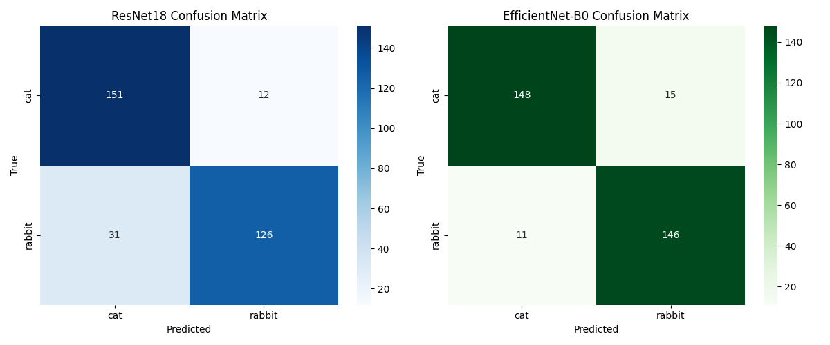
Final Test Results: Who Got It Right?
ResNet18 Results
EfficientNet-B0
✓ Got 277 right out of 320
✓ Got 294 correct
✗ Confused on 43 images
✓ 26 images false classified

Slide 11

Accuracy: Who's Better? The Numbers
ResNet18
Final Accuracy:
86.56%
Meaning: Out of 100 images, gets 87 right
Best Achieved:
EfficientNet-B0
86.56%
Final Accuracy:
Model Size: 11.7 Million weights
88.44%
Meaning: Out of 100 images, gets 88 right
Best Achieved:
91.87%
Model Size: 5.3 Million weights (55% smaller)

Slide 12
Key Findings
Modern Architecture Superiority
EfficientNet: +1.88% accuracy with 55% fewer parameters
Convergence & Stability
EfficientNet reaches peaks at Epoch 14(91.87%) vs Resnet plateau at 86,56%
Generalization Quality
EfficientNet: 5.00% overfitting gap vs ResNet: -1.25%

Slide 13
Parameter Efficiency Breakthrough
Accuracy-to-Parameter Ratio
+60-70%
EfficientNet efficiency vs ResNet
Better accuracy with 55% fewer parameters

Slide 14
Team Contributions
Aayush K.C.
Collected and organized the cat vs rabbit dataset
Researched ResNet18 and EfficientNet‑B0 architectures
Set up device configuration (GPU) and project environment
Implemented data loading, preprocessing, and train/val split
Laxmi Satyal
Assisted with data cleaning and verification of labels
Helped configure hyperparameters and monitor training runs
Summarized results and wrote parts of the project report
Reviewed slides and report for clarity and consistency
Pramesh Maharjan
Implemented EfficientNet‑B0 model and training pipeline
Performed detailed comparison with ResNet18 (metrics and behavior)
Generated and analyzed result plots (curves, confusion matrices)
Designed and prepared the presentation slides

Slide 15
Conclusions & Future Directions
Conclusions:
Transfer learning enables rapid convergence on limited data
Modern efficient architectures deliver superior accuracy-to-parameter ratios
EfficientNet-B0 recommended for production deployment
Future Directions:
Expand to multi-class classification (10+ animal types)
Ensemble methods (combine both models)
Deploy on edge devices (mobile, IoT)
Investigate adversarial robustness

Slide 16
Thank You!
Special Thanks to
Professor Wen Zhang
For guidance and instruction in CS 6900
Team FIG • Wright State University
December 3, 2025

